Slide 1
2.1 Origins and Evolution of HTML
- HTML was defined with SGML
- Original intent of HTML: General layout of
documents that could be displayed by a wide
variety of computers
- Recent versions:
- HTML 4.0 – 1997
- Introduced many new features and deprecated
many older features
- HTML 4.01 - 1999 - A cleanup of 4.0
- XHTML 1.0 - 2000
- Just 4.01 defined using XML, instead of SGML
- XHTML 1.1 – 2001
- Modularized 1.0, and drops frames
- We’ll use 1.0 Strict, except for frames

Slide 2
2.1 Origins and Evolution of HTML
(continued)
- Reasons to use XHTML, rather than HTML:
1. HTML has lax syntax rules, leading to sloppy and sometime ambiguous documents
- XHTML syntax is much more strict, leading to clean and clear documents in a standard form
2. HTML processors do not even enforce the few syntax rule that do exist in HTML
3. The syntactic correctness of XHTML documents can be validated
2.2 Basic Syntax
- Elements are defined by tags (markers)
- Tag format:
- Opening tag: <name>
- Closing tag: </name>
- The opening tag and its closing tag together
specify a container for the content they enclose

Slide 3
2.2 Basic Syntax (continued)
- Not all tags have content
- If a tag has no content, its form is <name />
- The container and its content together are called
an element
- If a tag has attributes, they appear between its
name and the right bracket of the opening tag
- Comment form: <!-- … -->
- Browsers ignore comments, unrecognizable tags,
line breaks, multiple spaces, and tabs
- Tags are suggestions to the browser, even if they
are recognized by the browser

Slide 4
2.3 Standard HTML Document Structure
- Every XHTML document must begin with:
<?xml version = ″1.0″ encoding = ″utf-8″ ?>
<!DOCTYPE html PUBLIC ″-//W3C//DTD XHTML 1.0 Strict//EN″
http://www.w3.org/TR/xhtml1/DTD/xhtml1-strict.dtd>
- <html>, <head>, <title>, and <body> are required
in every document
- The whole document must have <html> as its root
- html must have the xmlns attribute:
<html xmlns = ″http://www.w3.org/1999/xhtml″>
- A document consists of a head and a body
- The <title> tag is used to give the document a title,
which is normally displayed in the browser’s
window title bar (at the top of the display)
- Prior to XHTML 1.1, a document could have either
a body or a frameset

Slide 5
2.4 Basic Text Markup
- Text is normally placed in paragraph elements
- Paragraph Elements
- The <p> tag breaks the current line and inserts a
blank line - the new line gets the beginning of the
content of the paragraph
- The browser puts as many words of the
paragraph’s content as will fit in each line
<?xml version = ″1.0″ encoding = ″utf-8″ ?>
<!DOCTYPE html PUBLIC ″-//W3C//DTD XHTML 1.0 Strict//EN″
http://www.w3.org/TR/xhtml1/DTD/xhtml1-strict.dtd>
<!-- greet.html
A trivial document
-->
<html xmlns = ″http://www.w3.org/1999/xhtml″>
<head> <title> Our first document </title>
</head>
<body>
<p>
Greetings from your Webmaster!
</p>
</body>
</html>

Slide 6
2.4 Basic Text Markup (continued)
- Line breaks
- The effect of the <br /> tag is the same as that
of <p>, except for the blank line
- No closing tag!
- Example of paragraphs and line breaks
On the plains of hesitation <p> bleach the
bones of countless millions </p> <br />
who, at the dawn of victory <br /> sat down
to wait, and waiting, died.
- Typical display of this text:
On the plains of hesitation
bleach the bones of countless millions
who, at the dawn of victory
sat down to wait, and waiting, died.
- Preserving whitespace
- The text content of a <pre> element is
displayed as it is entered

Slide 7
2.4 Basic Text Markup (continued)
- Headings
- Six sizes, 1 - 6, specified with <h1> to <h6>
- 1, 2, and 3 use font sizes that are larger than the
default font size
- 4 uses the default size
- 5 and 6 use smaller font sizes
<!-- headings.html
An example to illustrate headings
-->
<html xmlns = ″http://www.w3.org/1999/xhtml″>
<head> <title> Headings </title>
</head>
<body>
<h1> Aidan’s Airplanes (h1) </h1>
<h2> The best in used airplanes (h2) </h2>
<h3> "We’ve got them by the hangarful" (h3)
</h3>
<h4> We’re the guys to see for a good used
airplane (h4) </h4>
<h5> We offer great prices on great planes
(h5) </h5>
<h6> No returns, no guarantees, no refunds,
all sales are final (h6) </h6>
</body>
</html>

Slide 8
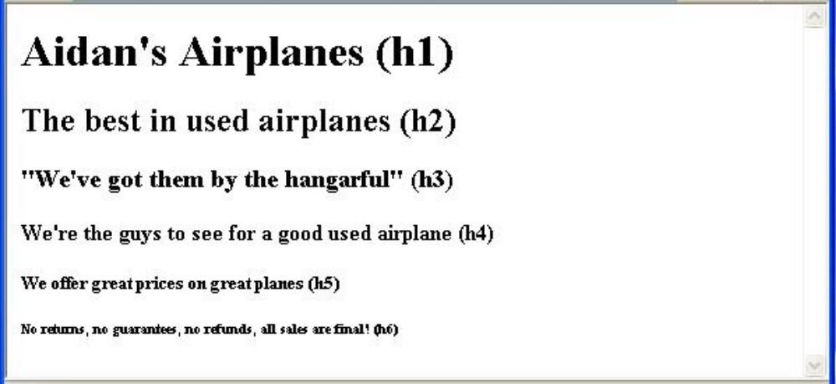
2.4 Basic Text Markup (continued)
- Blockquotes
- Content of <blockquote>
- To set a block of text off from the normal flow and
appearance of text
- Browsers often indent, and sometimes italicize
- Font Styles and Sizes (can be nested)
- Emphasis - <em> (often set in italics)
- Strong - <strong> (often set in boldface)
- Monospace - <code> (often set in Courier)

Slide 9
2.4 Basic Text Markup (continued)
- <em>, <strong>, and <code> are not affected if
they appear in the content of a <blockquote>,
unless there is a conflict (e.g.,<em> (italics))
- Superscripts and subscripts
- Subscripts with <sub>
- Superscripts with <sup>
Example: x<sub>2</sub><sup>3</sup>
Display: x₂³
- Inline versus block elements
- Block elements CANNOT be nested in inline
elements

Slide 10
2.4 Basic Text Markup (continued)
- All of this font size and font style stuff can be
done with style sheets, but these tags are not
yet deprecated
- Character Entities
Char. Entity Meaning
& &amp; Ampersand
< &lt; Less than
> &gt; Greater than
" &quot; Double quote
' &apos; Single quote
¼ &frac14; One quarter
½ &frac12; One half
¾ &frac34; Three quarters
° &deg; Degree
(space) &nbsp; Non-breaking space
- Horizontal rules
- <hr /> draws a line across the display, after a
line break
- The meta element (for search engines)
Used to provide additional information about a
document, with attributes, not content

Slide 11
2.5 Images
- Formats:
- GIF (Graphic Interchange Format)
- 8-bit color (256 different colors)
- JPEG (Joint Photographic Experts Group)
- 24-bit color (16 million different colors)
- Both use compression, but JPEG compression
is better
- Portable Network Graphics (PNG)
- Relatively new
- Should eventually replace both gif and jpeg
- Files are bigger than jpeg – no lost data!
- Images are inserted into a document with the
<img /> tag with the src attribute
- The alt attribute is required by XHTML
- Purposes:
1. Non-graphical browsers
2. Browsers with images turned off
<img src = "comets.jpg"
alt = "Picture of comets" />
- The <img> tag has 30 different attributes, including
width and height (in pixels)

Slide 12
2.5 Images (continued)
<!-- image.html
An example to illustrate an image
-->
<html xmlns = ″http://www.w3.org/1999/xhtml″>
<head> <title> Images </title>
</head>
<body>
<h1> Aidan's Airplanes </h1>
<h2> The best in used airplanes </h2>
<h3> "We've got them by the hangarful"
</h3>
<h2> Special of the month </h2>
<p>
1960 Cessna 210 <br />
577 hours since major engine overhaul
<br />
1022 hours since prop overhaul
<br /><br />
<img src = "c210new.jpg"
alt = "Picture of a Cessna 210"/>
<br />
Buy this fine airplane today at a
remarkably low price <br />
Call 999-555-1111 today!
</p>
</body>
</html>

Slide 13
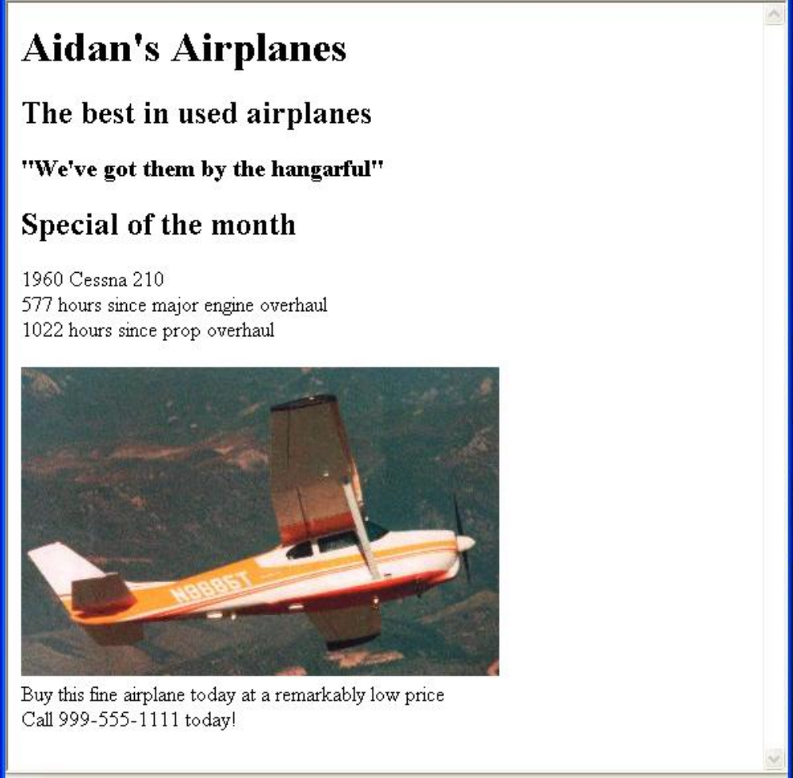
2.5 Images (continued)

Slide 14
2.5 Images (continued)
- W3C HTML Validation Service
http://validator.w3.org/file-upload.html
2.6 Hypertext Links
- Hypertext is the essence of the Web!
- A link is specified with the href (hypertext
reference) attribute of <a> (the anchor tag)
- The content of <a> is the visual link in the
document
- If the target is a whole document (not the one in
which the link appears), the target need not be
specified in the target document as being the
target
- Note: Relative addressing of targets is easier to
maintain and more portable than absolute
addressing

Slide 15
2.6 Hypertext Links (continued)
<!-- link.html
An example to illustrate a link
-->
<html xmlns = ″http://www.w3.org/1999/xhtml″>
<head> <title> Links </title>
</head>
<body>
<h1> Aidan's Airplanes </h1>
<h2> The best in used airplanes </h2>
<h3> "We've got them by the hangarful"
</h3>
<h2> Special of the month </h2>
<p>
1960 Cessna 210 <br />
<a href = "C210data.html">
Information on the Cessna 210 </a>
</p>
</body>
</html>

Slide 16
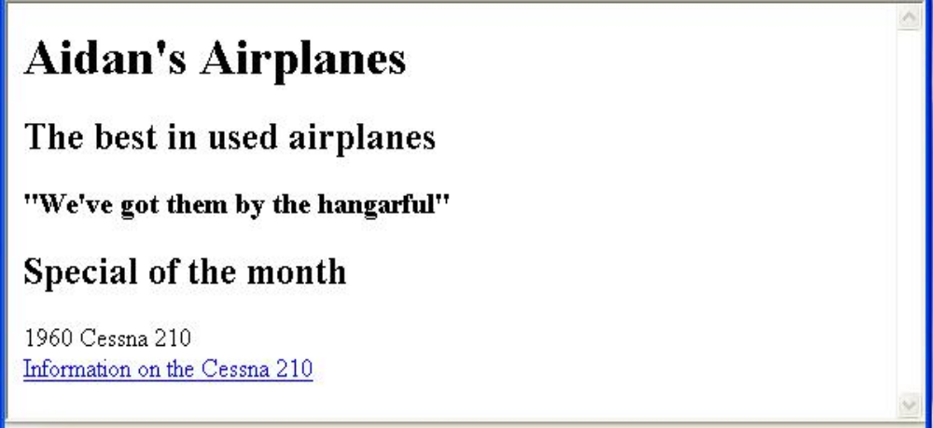
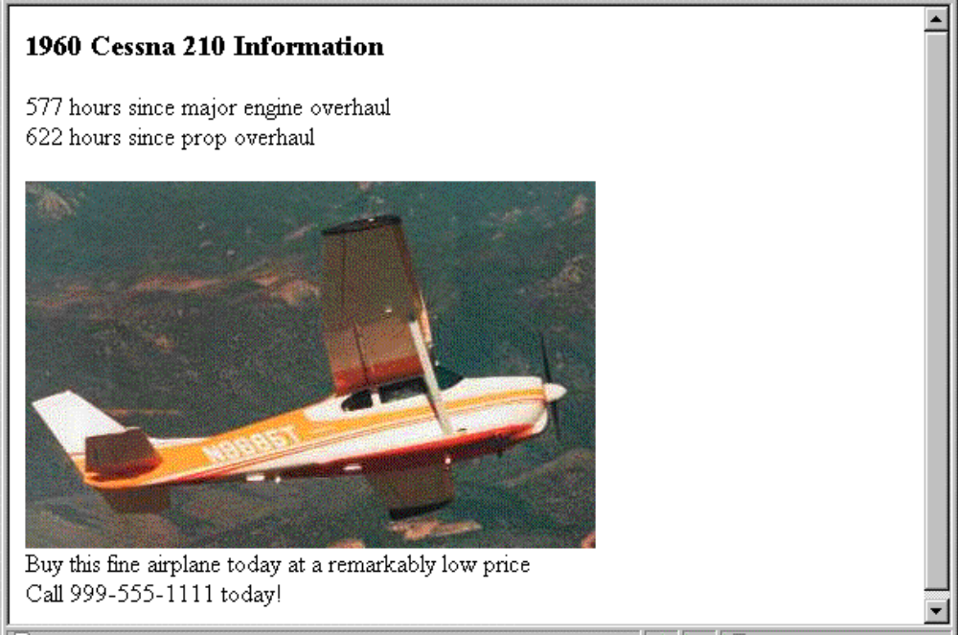
2.6 Hypertext Links (continued)

Slide 17
2.6 Hypertext Links (continued)
- If the target is not at the beginning of the
document, the target spot must be marked
- Target labels can be defined in many different
tags with the id attribute, as in
<h1 id = "baskets"> Baskets </h1>
- The link to an id must be preceded by a pound
sign (#); If the id is in the same document,
this target could be
<a href = "#baskets">
What about baskets? </a>
- If the target is in a different document, the
document reference must be included
<a href = "myAd.html#baskets”> Baskets </a>
- Style note: a link should blend in with the
surrounding text, so reading it without taking
the link should not be made less pleasant
- Links can have images:
<a href = "c210data.html">
<img src = "smallplane.jpg"
alt = "Small picture of an airplane" />
Info on C210 </a>

Slide 18
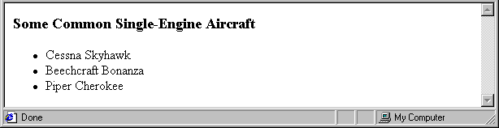
2.7 Lists
- Unordered lists
- The list is the content of the <ul> tag
- List elements are the content of the <li> tag
<h3> Some Common Single-Engine Aircraft </h3>
<ul>
<li> Cessna Skyhawk </li>
<li> Beechcraft Bonanza </li>
<li> Piper Cherokee </li>
</ul>
- Ordered lists
- The list is the content of the <ol> tag
- Each item in the display is preceded by a
sequence value

Slide 19
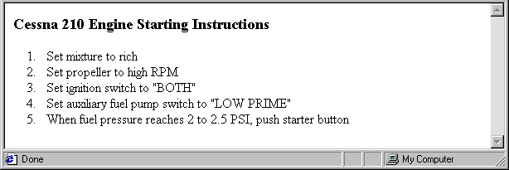
2.7 Lists (continued)
<h3> Cessna 210 Engine Starting Instructions
</h3>
<ol>
<li> Set mixture to rich </li>
<li> Set propeller to high RPM </li>
<li> Set ignition switch to "BOTH" </li>
<li> Set auxiliary fuel pump switch to
"LOW PRIME" </li>
<li> When fuel pressure reaches 2 to 2.5
PSI, push starter button </li>
</ol>
- Nested lists
- Any type list can be nested inside any type list
- The nested list must be in a list item

Slide 20
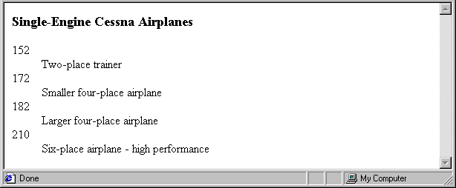
2.7 Lists (continued)
- Definition lists (for glossaries, etc.)
- List is the content of the <dl> tag
- Terms being defined are the content of the
<dt> tag
- The definitions themselves are the content
of the <dd> tag
<h3> Single-Engine Cessna Airplanes </h3>
<dl >
<dt> 152 </dt>
<dd> Two-place trainer </dd>
<dt> 172 </dt>
<dd> Smaller four-place airplane </dd>
<dt> 182 </dt>
<dd> Larger four-place airplane </dd>
<dt> 210 </dt>
<dd> Six-place airplane - high performance
</dd>
</dl>

Slide 21
2.8 Tables
- A table is a matrix of cells, each possibly having
content
- The cells can include almost any element
- Some cells have row or column labels and
some have data
- A table is specified as the content of a <table>
tag
- A border attribute in the <table> tag specifies a
border between the cells
- If border is set to "border", the browser’s
default width border is used
- The border attribute can be set to a number,
which will be the border width
- Without the border attribute, the table will have
no lines!
- Tables are given titles with the <caption> tag,
which can immediately follow <table>

Slide 22
2.8 Tables (continued)
- Each row of a table is specified as the content of
a <tr> tag
- The row headings are specified as the content of
a <th> tag
- The contents of a data cell is specified as the
content of a <td> tag
<table border = "border">
<caption> Fruit Juice Drinks </caption>
<tr>
<th> </th>
<th> Apple </th>
<th> Orange </th>
<th> Screwdriver </th>
</tr>
<tr>
<th> Breakfast </th>
<td> 0 </td>
<td> 1 </td>
<td> 0 </td>
</tr>
<tr>
<th> Lunch </th>
<td> 1 </td>
<td> 0 </td>
<td> 0 </td>
</tr>
</table>

Slide 23
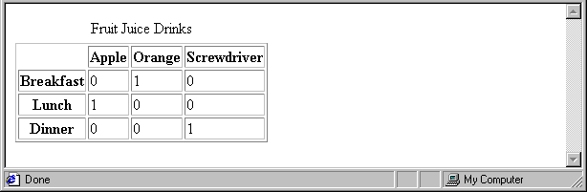
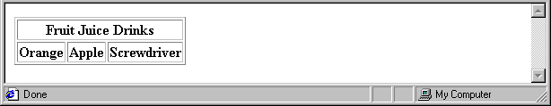
2.8 Tables (continued)
- A table can have two levels of column labels
- If so, the colspan attribute must be set in the
<th> tag to specify that the label must span
some number of columns
<tr>
<th colspan = "3"> Fruit Juice Drinks </th>
</tr>
<tr>
<th> Orange </th>
<th> Apple </th>
<th> Screwdriver </th>
</tr>

Slide 24
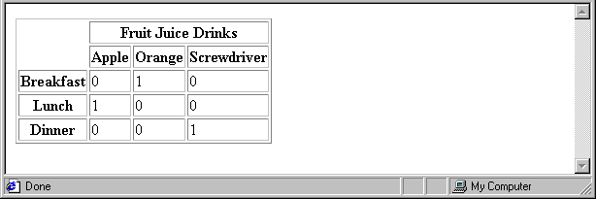
2.8 Tables (continued)
- If the rows have labels and there is a spanning
column label, the upper left corner must be
made larger, using rowspan
<table border = "border">
<tr>
<td rowspan = "2"> </td>
<th colspan = "3"> Fruit Juice Drinks
</th>
</tr>
<tr>
<th> Apple </th>
<th> Orange </th>
<th> Screwdriver </th>
</tr>
…
</table>

Slide 25
2.8 Tables (continued)
- The align attribute controls the horizontal
placement of the contents in a table cell
- Values are left, right, and center (default)
- align is an attribute of <tr>, <th>, and <td>
elements
- The valign attribute controls the vertical
placement of the contents of a table cell
- Values are top, bottom, and center (default)
- valign is an attribute of <th> and <td> elements
→ SHOW cell_align.html and display it
- The cellspacing attribute of <table> is used to
specify the distance between cells in a table
- The cellpadding attribute of <table> is used to
specify the spacing between the content of a cell
and the inner walls of the cell

Slide 26
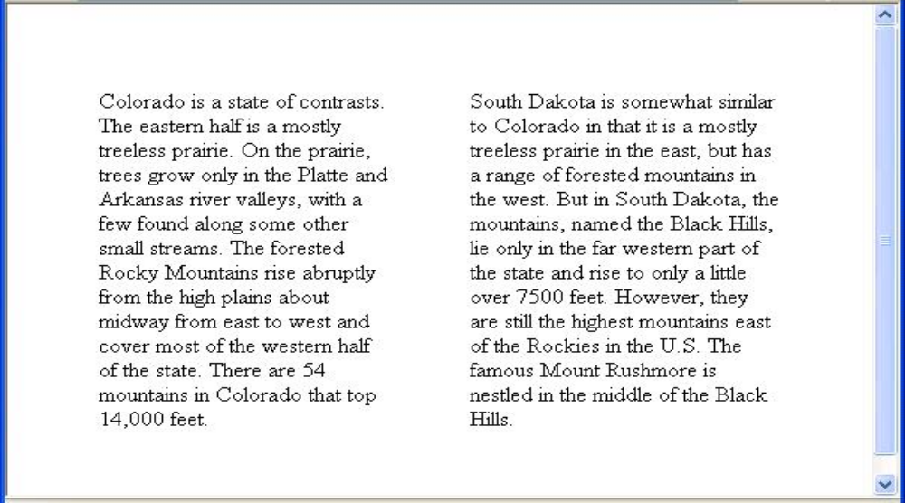
2.8 Tables (continued)
<table cellspacing = "50">
<tr>
<td> Colorado is a state of …
</td>
<td> South Dakota is somewhat…
</td>
</tr>
</table>
- Table Sections
- Header, body, and footer, which are the elements:
thead, tbody, and tfoot
- If a document has multiple tbody elements, they
are separated by thicker horizontal lines

Slide 27
2.9 Forms
- A form is the usual way information is gotten from
a browser to a server
- HTML has tags to create a collection of objects that
implement this information gathering
- The objects are called widgets or controls
(e.g., radio buttons and checkboxes)
- When the Submit button of a form is clicked, the
form’s values are sent to the server for processing
- All of the widgets, or components of a form are
defined in the content of a <form> tag
- The only required attribute of <form> is action,
which specifies the URL of the application that is
to be called when the Submit button is clicked
action =
"http://www.cs.ucp.edu/cgi-bin/survey.pl"
- If the form has no action, the value of action is
the empty string

Slide 28
2.9 Forms (continued)
- The method attribute of <form> specifies one of
the two possible techniques of transferring the
form data to the server, get and post
- get and post are discussed in Chapter 10
- Widgets
- Many are created with the <input> tag
- The type attribute of <input> specifies the kind of
widget being created
1. Text
- Creates a horizontal box for text input
- Default size is 20; it can be changed with the
size attribute
- If more characters are entered than will fit, the
box is scrolled (shifted) left

Slide 29
2.9 Forms (continued)
- If you don’t want to allow the user to type more
characters than will fit, set maxlength, which
causes excess input to be ignored
<input type = "text" name = "Phone"
size = "12" />
- Widgets should be placed in label elements
<label> Phone: <input type = "text"
name = "phone" />
</label>
2. Password – just like text except asterisks are
displayed, rather than the input characters
3. Checkboxes - to collect multiple choice input
- Every checkbox requires a value attribute,
which is the widget’s value in the form data
when the checkbox is ‘checked’
- A checkbox that is not ‘checked’ contributes
no value to the form data
- By default, no checkbox is initially ‘checked’
- To initialize a checkbox to ‘checked’, the
checked attribute must be set to "checked"

Slide 30
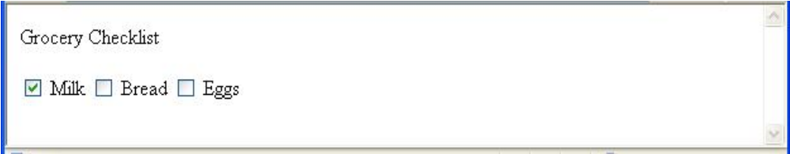
2.9 Forms (continued)
- Widgets (continued)
Grocery Checklist
<form action = "">
<p>
<label> <input type = "checkbox" name ="groceries"
value = "milk" checked = "checked" />
Milk </label>
<label> <input type = "checkbox" name ="groceries"
value = "bread“ />
Bread </label>
<label> <input type = "checkbox" name = "groceries"
value= "eggs" />
Eggs </label>
</p>
</form>
4. Radio Buttons - collections of checkboxes in
which only one button can be ‘checked’ at a
time
- Every button in a radio button group MUST
have the same name

Slide 31
2.9 Forms (continued)
- Widgets (continued)
4. Radio Buttons (continued)
- If no button in a radio button group is
‘pressed’, the browser often ‘presses’ the
first one
Age Category
<form action = "">
<p>
<label> <input type = "radio" name = "age"
value = "under20" checked = "checked" />
0-19 </label>
<label> <input type = "radio" name = "age"
value = "20-35" /> 20-35 </label>
<label> <input type = "radio" name = "age"
value = "36-50" /> 36-50 </label>
<label> <input type = "radio" name = "age"
value = "over50" /> Over 50 </label>
</p>
</form>

Slide 32
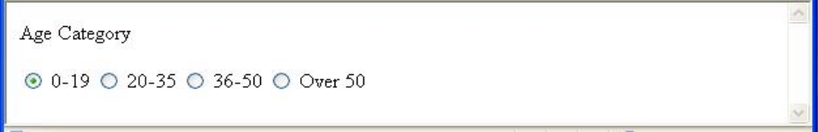
2.9 Forms (continued)
Widgets (continued)
5. The <select> tag
- There are two kinds of menus, those that
behave like checkboxes and those that
behave like radio buttons (the default)
- Menus that behave like checkboxes are
specified by including the multiple attribute,
which must be set to "multiple"
- The name attribute of <select> is required
- The size attribute of <select> can be
included to specify the number of menu
items to be displayed (the default is 1)
- If size is set to > 1 or if multiple is
specified, the menu is displayed as a
pop-up menu

Slide 33
2.9 Forms (continued)
- Widgets (continued)
5. <select> (continued)
- Each item of a menu is specified with an
<option> tag, whose pure text content
(no tags) is the value of the item
- An <option> tag can include the selected
attribute, which when assigned "selected"
specifies that the item is preselected
Grocery Menu - milk, bread, eggs, cheese
<form action = "">
<p>
With size = 1 (the default)
<select name = "groceries">
<option> milk </option>
<option> bread </option>
<option> eggs </option>
<option> cheese </option>
</select>
</p>
</form>

Slide 34
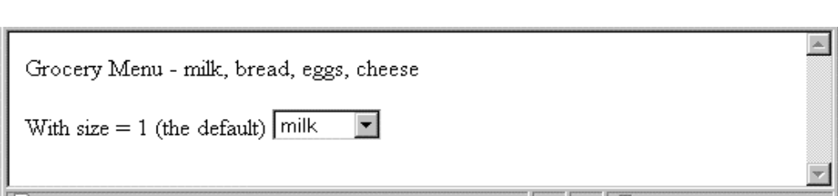
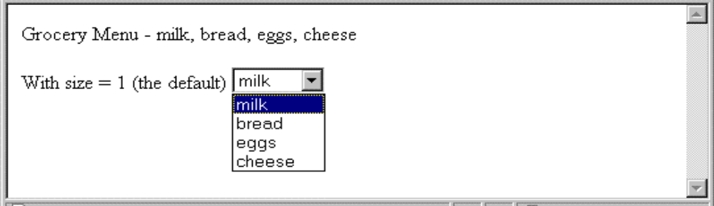
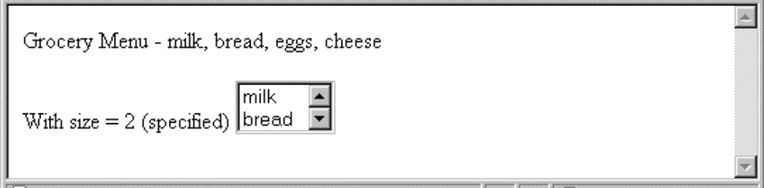
2.9 Forms (continued)
- Widgets (continued)
- After clicking the menu:
- After changing size to 2:

Slide 35
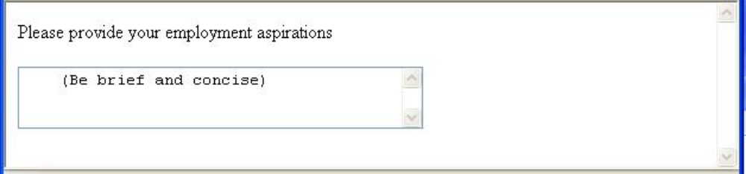
2.9 Forms (continued)
Widgets (continued)
6. Text areas - created with <textarea>
- Usually include the rows and cols attributes
to specify the size of the text area
- Default text can be included as the content of
<textarea>
- Scrolling is implicit if the area is overfilled
Please provide your employment aspirations
<form action = "">
<p>
<textarea name = "aspirations" rows = "3”
cols = "40">
(Be brief and concise)
</textarea>
</p>
</form>

Slide 36
2.9 Forms (continued)
- Widgets (continued)
7. Reset and Submit buttons
- Both are created with <input>
<input type = "reset"
value = "Reset Form" />
<input type = "submit”
value = "Submit Form" />
- Submit has two actions:
1. Encode the data of the form
2. Request that the server execute the
server-resident program specified as the
value of the action attribute of <form>
- A Submit button is required in every form
→SHOW popcorn.html and display it

Slide 37
2.11 Syntactic Differences between
HTML & XHTML
- Case sensitivity
- Closing tags
- Quoted attribute values
- Explicit attribute values
- id and name attributes
- Element nesting

